Slide 1
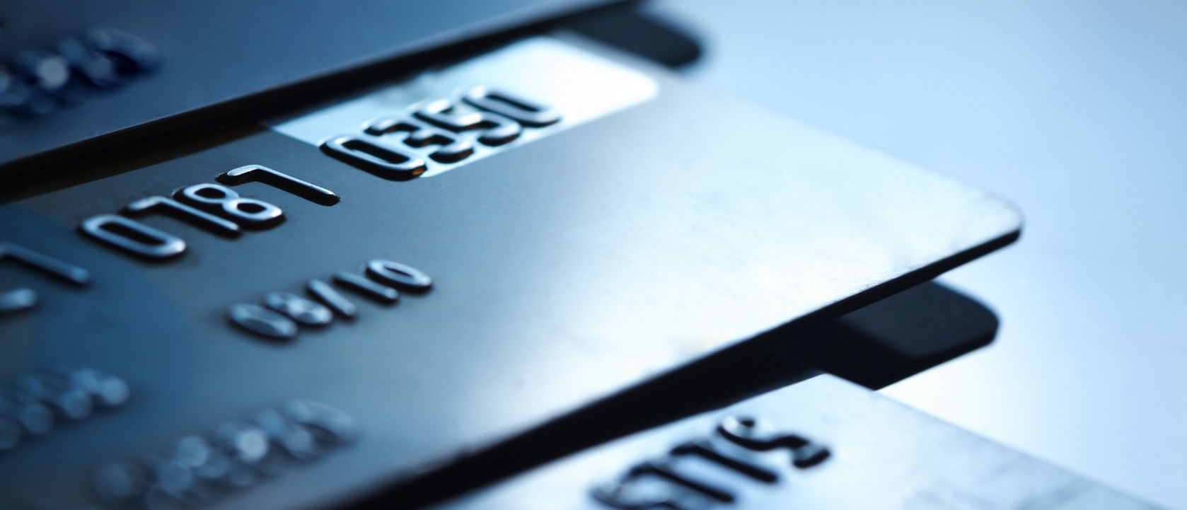
early|INVESTORS™
Home
About Us
Approach
Clients
Partnerships
Investment
Upcoming Events
Feature
In a 2003 study of Ohio State students, University administrators found they lost more students to credit card debt than to academic failure.
(Utah Mentor, Digital News, 2003)
Early Investors Inc. is a not-for-profit, 501 (c) (3) organization, dedicated to inspire and enrich lives through financial empowerment. Since its inception in 2010, Early Investors has helped hundreds of people in Massachusetts become better equipped to manage their finances and avoid many of the pitfalls that have befallen so many individuals and families across America.
We’re not talking about making people rich, but rather making them responsible about money and finances so that they can lead financially secure lives, realize their personal aspirations and contribute to the growth and development of their community.
problem at-hand
Let’s face it, lack of financial literacy and poor financial decision-making can set one’s life on a negative course and drastically limit one’s future chances in life.
The term “financial literacy” means the ability to make informed judgments & effective decisions regarding the use and management of money. And yet, common belief is that only budgeting, banking and/or balancing a checkbook will rescue people from financial illiteracy. We, at Early Investors (E.I.) believe otherwise.
There is a spectrum of inter-related topics that lead to informed judgments and effective decisions regarding money, which seldom are explored.
And while individuals, families, communities and even governments continue to grapple with serious economic and financial challenges, financial education, or as we like to call it, financial empowerment, is nonexistent in schools, homes or any conversation for that matter.
We, individually and collectively, must not only remove the blinders and acknowledge the fact that financial empowerment is an accelerator out of financial & economic challenges but also that we need to act immediately (chatter needs to stop)!
early|INVESTORS™
Home
About Us
Problem At-Hand
Approach
Clients
Testimonials
Photo Gallery
Upcoming Events
Partnerships
Investment
Feature
Contact Us

Slide 2
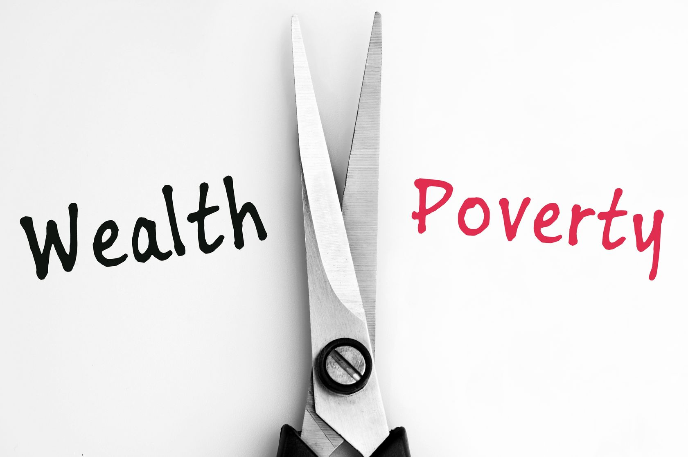

early|INVESTORS™
Home
About Us
Approach
Clients
Partnerships
Investment
Upcoming Events
Feature
MISSION STATEMENT
Although our mission reads “to inspire and enrich lives through financial empowerment”, essentially, we are teaching a life-skill --- a skill that is an absolute requirement for survival and to be Financially Independent, Responsible, Secure & Successful
VISION
Promote Financial Independence,
Responsibility, Security, and Success
All so often, we witness stories of financial tragedy & despair. Sometimes it is through our own lens or that of a family member, loved one or friend. Whether it is mounting debt, loss of a job, inability to cover health care or funeral costs, a foreclosure, bankruptcy, or divorce, it rocks us to the core. This is usually accompanied by a whirlwind of emotional, physical and mental pain -- feeling of hopelessness, anguish, fear, uncertainty & isolation.
It’s these painstaking stories that validate the need for financial education. Rather than stand idle, a group of passionate citizens decided to act.
Armed with an uncompromising belief that financial education is the passport to a more abundant, fulfilling and prosperous life, the group set out to chart a different path for people, especially young, at-risk people in Massachusetts.
Thus, Early Investors was born.
BOARD OF DIRECTORS
Nadir S. Ahmed
Alix Hogu
Nislo B. Galvao
We rely on members who are passionate, committed, active, result-oriented & forward-thinkers.
Early Investors is now seeking individuals to help in its fundraising efforts. If interested in becoming a board member, please contact……
early|INVESTORS™
Home
About Us
Problem At-Hand
Approach
Clients
Testimonials
Photo Gallery
Upcoming Events
Partnerships
Investment
Feature
Contact Us

